Slide 1
Class 24
The Last Dance

Slide 2
Turn video on, open chat,
greet your colleagues in the chat!
Discussion prompt:
What role do research labs at companies like Google have in the fourth estate (journalism)?

Slide 3
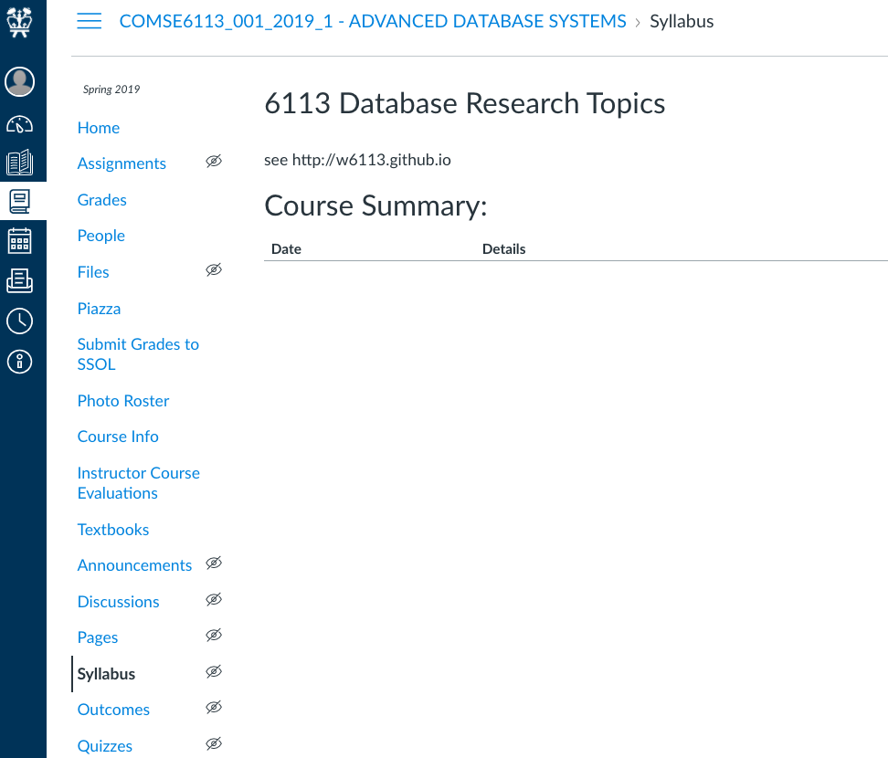
Logistics
now showcase!!!
now Course Evals!
12/14 Report due

Slide 4
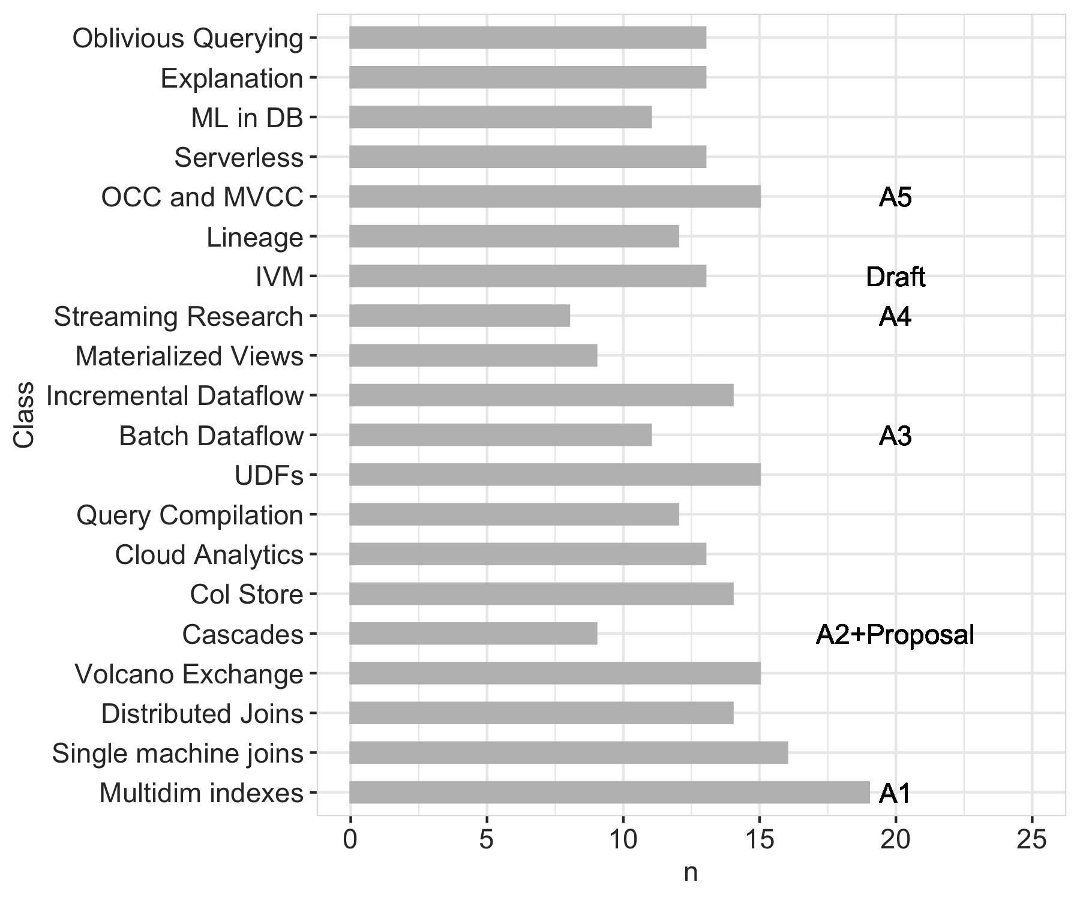
Last class
Advanced Topics
Streaming & Theory
Multi machine
Single Machine
First class

Slide 5
Number of Reviews

Slide 6
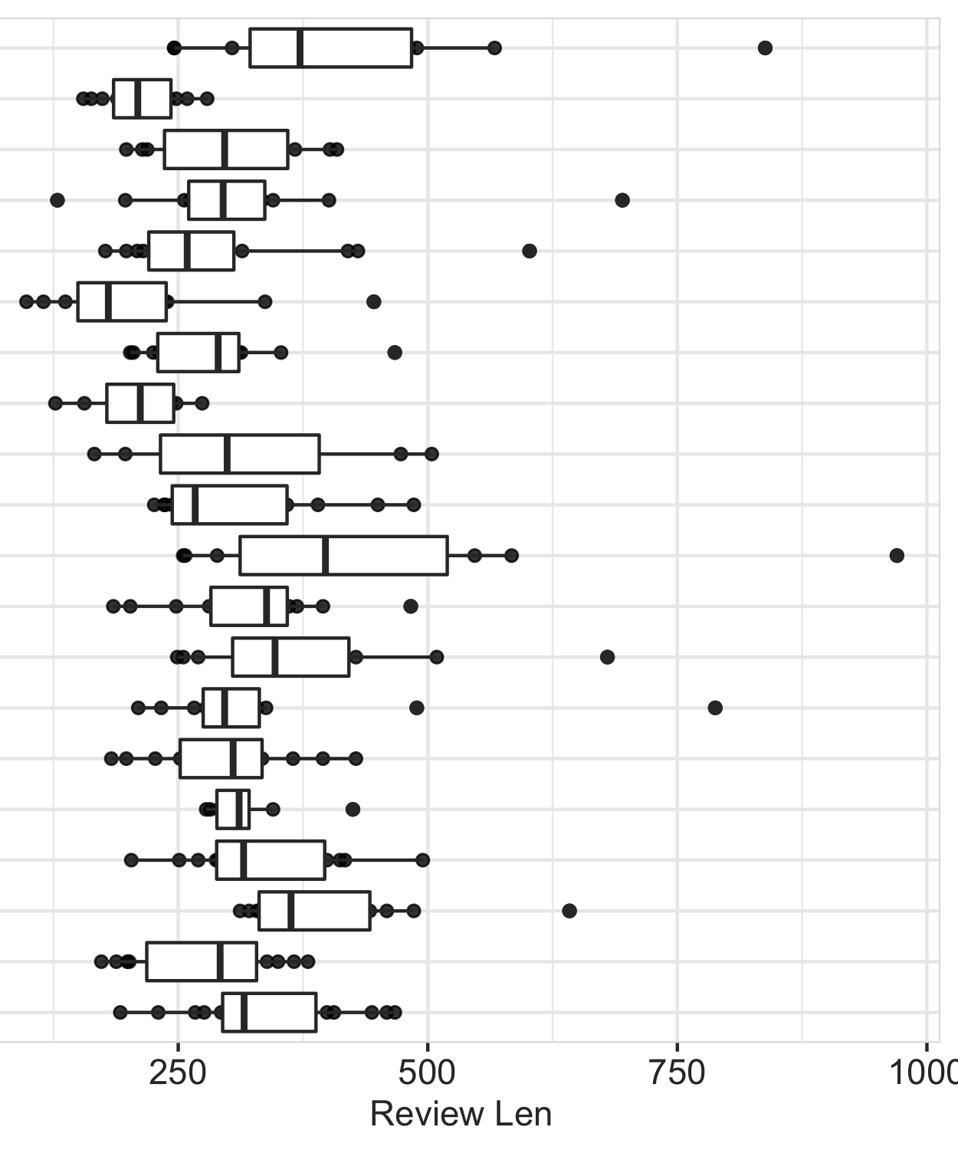
Number of Reviews

Slide 7
Format
7 projects
5 minutes presentation
5 minutes Q&A
Deka will control slides
Pert-Q-Pan: Perturbation Queries in Pandas
Kh4m3le0n: Cloud Gaming Applications
Extending Databass for columnar stores
Query Execution in Wasm
Extend Column-oriented Execution to Databass
How Smokey?
Interactive Exploration of 1M Images

Slide 8
Each group assigns notetaker
What is your favorite data management topic?
(or talk about anything else, summarize whatever you discuss)

Slide 9
Logistics
now showcase!!!
now Course Evals!
12/14 Report due

Slide 10
Class 23
Oblivious Queries

Slide 11
Turn video on, open chat,
greet your colleagues in the chat!
Discussion prompt:
What was surprisingly good
about virtual fall semester?

Slide 12

Logistics
Today OH → 4-5PM
now Course Evaluations!
12/9 Cong Yu’s DSI talk
12/10 In-class Presentations
12/14 Report due

Slide 13
Showcase Logistics Thurs 12/10
7 groups
Each team: 5 min presentation, 5 min feedback
Every team member should speak
Timing is strict, so practice!

Slide 14
Presentation Slides Submission
Submit slides at https://forms.gle/Ck1FX3higgbVUHkA9
Google slides strongly preferred
Each team submits once
Deadline for slide submission
Tuesday, 12/08/2021 11:59 PM

Slide 15
Showcase Details
Presentation should contain (in substance, not necessarily slides)
Motivation and hypotheses
Technical challenge and contribution
Related work and how they are related
Simple example to illustrate idea
Technical insights/experimental findings so far
Demos as GIFs or embedded videos
Feedback: 1-2 questions you’d like feedback on

Slide 16
Each group assigns notetaker
Share your tips on reading and reviewing papers and how it changed this semester. Use OblivDB paper (or another paper from class) as concrete example.

Slide 17
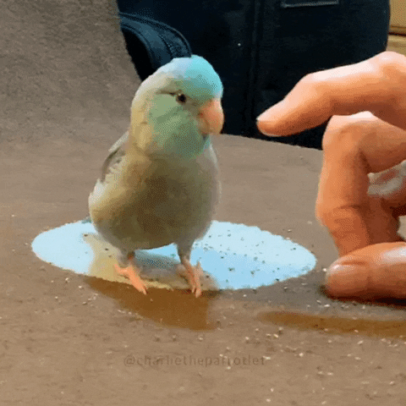
Support your colleagues
for speaking up
A quick thanks or follow up
is great

Slide 18
Each group assigns notetaker
Share your tips on reading and reviewing papers and how it changed this semester. Use OblivDB paper (or another paper from class) as concrete example.

Slide 19
Each group assigns notetaker
G1: What is the technical idea in OblivDB and what could be follow-up work?
G2: What if data was regularly appended to the base tables? Could IMV be made oblivious?

Slide 20

Support your colleagues
for speaking up
A quick thanks or follow up
is great

Slide 21
Each group assigns notetaker
G1: What is the technical idea in OblivDB and what could be follow-up work?
G2: What if data was regularly appended to the base tables? Could IMV be made oblivious?

Slide 22
Class 22
Explanation

Slide 23
Turn video on, open chat,
greet your colleagues in the chat!
Discussion prompt:
Cake vs Pie? Discuss

Slide 24
Logistics
12/9 Cong Yu’s DSI talk
12/10 In-class Presentations
12/14 Report due

Slide 25
Showcase Logistics Thurs 12/10
7 groups
Each team: 5 min presentation, 5 min feedback
Every team member should speak
Timing is strict, so practice!

Slide 26
Presentation Slides Submission
Submit slides at https://forms.gle/Ck1FX3higgbVUHkA9
Google slides strongly preferred
Each team submits once
Deadline for slide submission
Tuesday, 12/08/2021 11:59 PM

Slide 27
Showcase Details
Presentation should contain (in substance, not necessarily slides)
Motivation and hypotheses
Technical challenge and contribution
Related work and how they are related
Simple example to illustrate idea
Technical insights/experimental findings so far
Demos as GIFs or embedded videos
Feedback: 1-2 questions you’d like feedback on

Slide 28
Each group assigns notetaker
G1: Think about the data science/analytics pipeline. What forms of explanation could be killer apps?
G2: How does explanation compare and contrast from outlier detection or machine learning interpretation?

Slide 29
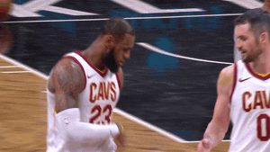
Support your colleagues
for speaking up
A quick thanks or follow up
is great

Slide 30
Each group assigns notetaker
G1: Think about the data science/analytics pipeline. What forms of explanation could be killer apps?
G2: How does explanation compare and contrast from outlier detection or machine learning interpretation?

Slide 31
Class 21
ML in DBs

Slide 32
Turn video on, open chat,
greet your colleagues in the chat!
Discussion prompt:
How was your break?

Slide 33
Logistics
12/9 Cong Yu’s DSI talk
12/10 In-class Presentations
12/14 Report due

Slide 34
Showcase Logistics Thurs 12/10
7 groups
Each team: 5 min presentation, 5 min feedback
Every team member should speak
Timing is strict, so practice!
Submit slides by Monday night before showcase
Deka will share & control screen for all presentations

Slide 35
Showcase Details
Presentation should contain (in substance, not necessarily slides)
Motivation and hypotheses
Technical challenge and contribution
Related work and how they are related
Simple example to illustrate idea
Technical insights/experimental findings so far
GIF/video of demos/screenshots (if applicable)
Feedback: 1-2 questions you’d like feedback on

Slide 36
Each group assigns notetaker
G1: Given the speed that ML and ML-systems are evolving, discuss impactful applications of ML in DB. What could be its “killer app”?
G2: Discuss the technical challenges and how DBs could be integrated into the ML/data science pipeline.

Slide 37

Support your colleagues
for speaking up
A quick thanks or follow up
is great

Slide 38
Each group assigns notetaker
G1: Given the speed that ML and ML-systems are evolving, discuss impactful applications of ML in DB. What could be its “killer app”?
G2: Discuss the technical challenges and how DBs could be integrated into the ML/data science pipeline.

Slide 39
Class 20
Serverless

Slide 40
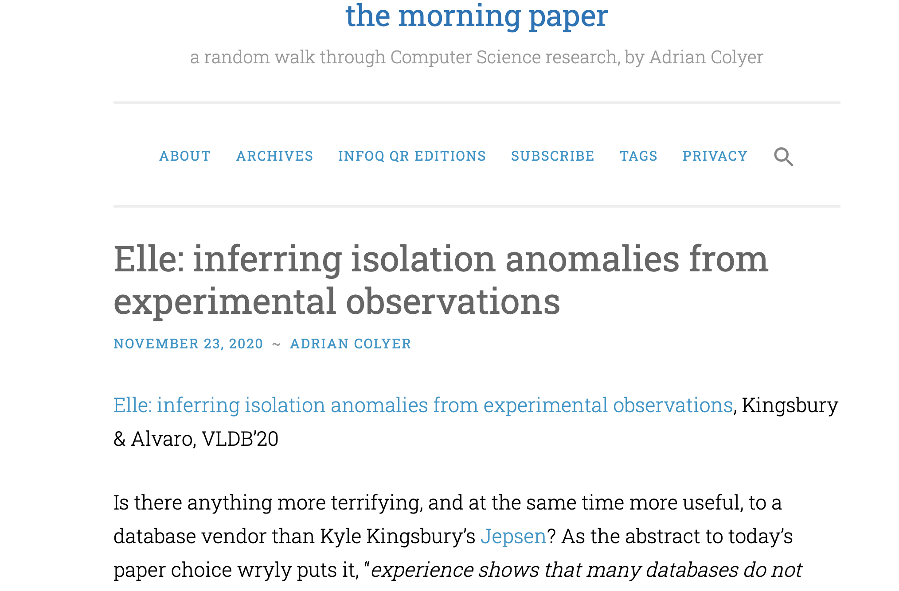
Turn video on, open chat,
greet your colleagues in the chat!
Discussion prompt:
blog.acolyer.org

Slide 41

Logistics
11/26 Thanksgiving break
12/10 In-class Presentations
12/14 Report due

Slide 42
Showcase Logistics Thurs 12/10
7 groups
Each team: 5 min presentation, 5 min feedback
Every team member should speak
Timing is strict, so practice!
Submit slides by Monday night before showcase
Deka will share & control screen for all presentations

Slide 43
Showcase Details
Presentation should contain (in substance, not necessarily slides)
Motivation and hypotheses
Technical challenge and contribution
Related work and how they are related
Simple example to illustrate idea
Technical insights/experimental findings so far
GIF/video of demos/screenshots (if applicable)
Feedback: 1-2 questions you’d like feedback on

Slide 44
DB seminar talks
9/29 Julia Stoyanovich (NYU)
Responsible Data Management
10/13 Wolfgang Gatterbauer (Northeastern)
QueryVis
10/20 Kostas Karanasos (Microsoft Gray Labs)
Lab overview + In-db ML inference
10/27 Vasiliki Kalavri (Boston U)
Streaming Research
11/10 Aaron Elmore (UChicago)
CrocodileDB
12/9 Cong Yu (Google)
Fact Checking & Structure Data
Zoom link in slack

Slide 45
Each group assigns notetaker
G1: Micro-adaptivity is for “flavors” for each primitive. What challenges arise with general adaptivity at the operator or plan level? Assess wrt a specific execution model, data rep, etc
G2: Adaptivity is typically based on hope: that the future workloads/data will be like the present/past. Discuss data systems where the future could be predicted reliably.

Slide 46
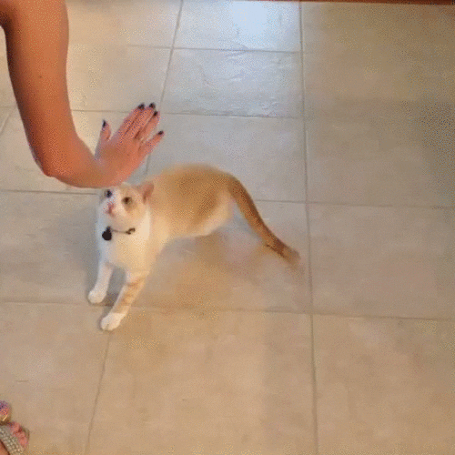
Support your colleagues
for speaking up
A quick thanks or follow up
is great

Slide 47
Each group assigns notetaker
G1: Micro-adaptivity is for “flavors” for each primitive. What challenges arise with general adaptivity at the operator or plan level? Assess wrt a specific execution model, data rep, etc
G2: Adaptivity is typically based on hope: that the future workloads/data will be like the present/past. Discuss data systems where the future could be predicted reliably.

Slide 48
Class 20
Serverless

Slide 49
Turn video on, open chat,
greet your colleagues in the chat!
Discussion prompt:
What’s an awesome service
that you use or just like?
(tech, databases, or otherwise)

Slide 50
Logistics
(optional) A5 due tomorrow. Submission link up tonight
Junyoung leads discussion on Tuesday
12/10 In-class Presentations
12/14 Report due

Slide 51
DB seminar talks
9/29 Julia Stoyanovich (NYU)
Responsible Data Management
10/13 Wolfgang Gatterbauer (Northeastern)
QueryVis
10/20 Kostas Karanasos (Microsoft Gray Labs)
Lab overview + In-db ML inference
10/27 Vasiliki Kalavri (Boston U)
Streaming Research
11/10 Aaron Elmore (UChicago)
CrocodileDB
12/9 Cong Yu (Google)
Fact Checking & Structure Data
Zoom link in slack

Slide 52
Each group assigns notetaker
G1: Consider serializable OLTP and how to translate its components to serverless. What translates well, what doesn’t? Are three workarounds?
G2: Consider an OLAP engine (say, snowflake), and how to translate it to serverless functions. Discuss the pros, and technical challenges (and potential workarounds).

Slide 53

Support your colleagues
for speaking up
A quick thanks or follow up
is great

Slide 54
Each group assigns notetaker
G1: Consider serializable OLTP and how to translate its components to serverless. What translates well, what doesn’t? Are three workarounds?
G2: Consider an OLAP engine (say, snowflake), and how to translate it to serverless functions. Discuss the pros, and technical challenges (and potential workarounds).

Slide 55
Class 19
OCC

Slide 56
Turn video on, open chat,
greet your colleagues in the chat!
Discussion prompt:

Slide 57
Logistics
Recitation cancelled (postponed?)
12/10 In-class Presentations
12/14 Report due

Slide 58
DB seminar talks
9/29 Julia Stoyanovich (NYU)
Responsible Data Management
10/13 Wolfgang Gatterbauer (Northeastern)
QueryVis
10/20 Kostas Karanasos (Microsoft Gray Labs)
Lab overview + In-db ML inference
10/27 Vasiliki Kalavri (Boston U)
Streaming Research
11/10 Aaron Elmore (UChicago)
CrocodileDB
12/9 Cong Yu (Google)
Fact Checking & Structure Data
Zoom link in slack

Slide 59
Each group assigns notetaker
G1: OCC’s validation requires checking all xacts between start and finished-tid, which can be slow. How can this O(n) cost be avoided?
G2: Suppose conflicts are rare. What issues might limit OCC’s scalability?

Slide 60

Support your colleagues
for speaking up
A quick thanks or follow up
is great

Slide 61
Each group assigns notetaker
G1: OCC’s validation requires checking all xacts between start and finished-tid, which can be slow. How can this O(n) cost be avoided?
G2: Suppose conflicts are rare. What issues might limit OCC’s scalability?

Slide 62
Class 18
Datalog and Recursive Queries

Slide 63
Turn video on, open chat,
greet your colleagues in the chat!
Discussion prompt:
How much does privacy
affect your choices of services to use?

Slide 64
Logistics
Annotated project drafts sent via slack
Come to office hours to discuss
Next Tuesday’s 11/17 recitation cancelled (postponed?)
12/10 In-class Presentations
12/14 Report due

Slide 65
Each group assigns notetaker
G1: Discuss use cases for lineage. Report details (user, goals, how to use the lineage, and drawbacks) for top 2 use cases.
G2: How could lineage be materialized? Efficiently?

Slide 66
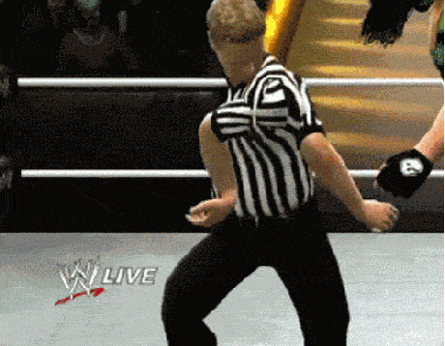
Support your colleagues
for speaking up
A quick thanks or follow up
is great

Slide 67
Each group assigns notetaker
G1: Discuss use cases for lineage. Report details (user, goals, how to use the lineage, and drawbacks) for top 2 use cases.
G2: How could lineage be materialized? Efficiently?

Slide 68
Class 18
Datalog and Recursive Queries

Slide 69
Turn video on, open chat,
greet your colleagues in the chat!
Discussion prompt:
Choose your own topic!

Slide 70
Logistics
Optional A5 is out (lineage)
Optional datalog “assignment”
Paper reviews are released
Come to recitation/office hours to discuss, or ask on Slack

Slide 71
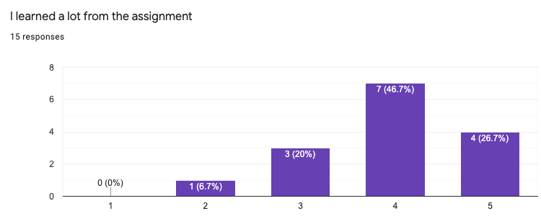
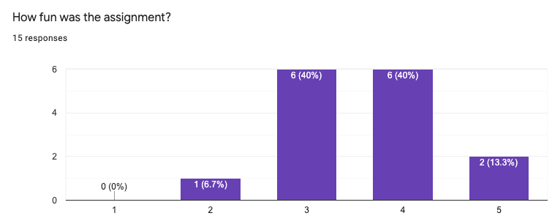

Slide 72
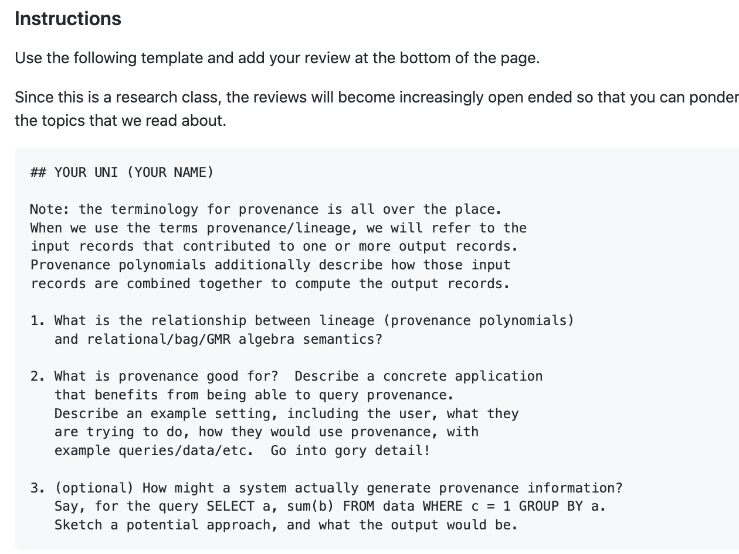
Reviews

Slide 73
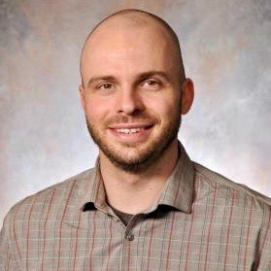
DB seminar talks
9/29 Julia Stoyanovich (NYU)
Responsible Data Management
10/13 Wolfgang Gatterbauer (Northeastern)
QueryVis
10/20 Kostas Karanasos (Microsoft Gray Labs)
Lab overview + In-db ML inference
10/27 Vasiliki Kalavri (Boston U)
Streaming Research
11/10 Aaron Elmore (UChicago)
CrocodileDB
12/? Cong Yu (Google)
Fact Checking & Structure Data
Zoom link in slack

Slide 74
Each group assigns notetaker
G1: What are some potentially impactful use cases for datalog as compared to SQL? Report the top 2.
G2: Datalog is equivalent to first order logic. What makes negation and general expressions challenging? Report 1 example.
G3: A4 was about hypothesis-driven experiment design. Discuss what you did in A4 and what you learned. Report the top 2 suggestions for exp design.

Slide 75

Support your colleagues
for speaking up
A quick thanks or follow up
is great

Slide 76
Each group assigns notetaker
G1: What are some potentially impactful use cases for datalog as compared to SQL? Report the top 2.
G2: Datalog is equivalent to first order logic. What makes negation and general expressions challenging? Report 1 example.
G3: A4 was about hypothesis-driven experiment design. Discuss what you did in A4 and what you learned. Report the top 2 suggestions for exp design.

Slide 77
Class 17
Datalog and Recursive Queries

Slide 78
Turn video on, open chat,
greet your colleagues in the chat!
Discussion prompt:
Where do you usually get your news?

Slide 79
Logistics
PC reviews due tomorrow
A4 due tomorrow

Slide 80
DB seminar talks
9/29 Julia Stoyanovich (NYU)
Responsible Data Management
10/13 Wolfgang Gatterbauer (Northeastern)
QueryVis
10/20 Kostas Karanasos (Microsoft Gray Labs)
Lab overview + In-db ML inference
10/27 Vasiliki Kalavri (Boston U)
Streaming Research
11/10 Aaron Elmore (UChicago)
CrocodileDB
12/? Cong Yu (Google)
Fact Checking & Structure Data
Zoom link in slack

Slide 81
Each group assigns notetaker
Discuss tips for reading papers & writing good reviews
Each group shares 2 tips with the class

Slide 82

Support your colleagues
for speaking up
A quick thanks or follow up
is great

Slide 83
Each group assigns notetaker
Discuss tips for reading papers & writing good reviews
Each group shares 2 tips with the class

Slide 84
Class 16
Inc Mat Views

Slide 85
Turn video on, open chat,
greet your colleagues in the chat!
Discussion prompt:
Discuss Tuesday’s lecture

Slide 86
Logistics
Paper draft due TODAY
https://easychair.org/conferences/?conf=w611320
No class on election day
Next 2 reviews will be dedicated to your assigned PC papers
Assignments out tomorrow

Slide 87
DB seminar talks
9/29 Julia Stoyanovich (NYU)
Responsible Data Management
10/13 Wolfgang Gatterbauer (Northeastern)
QueryVis
10/20 Kostas Karanasos (Microsoft Gray Labs)
Lab overview + In-db ML inference
10/27 Vasiliki Kalavri (Boston U)
Streaming Research
11/10 Aaron Elmore (UChicago)
CrocodileDB
12/? Cong Yu (Google)
Fact Checking & Structure Data
Zoom link in slack

Slide 88
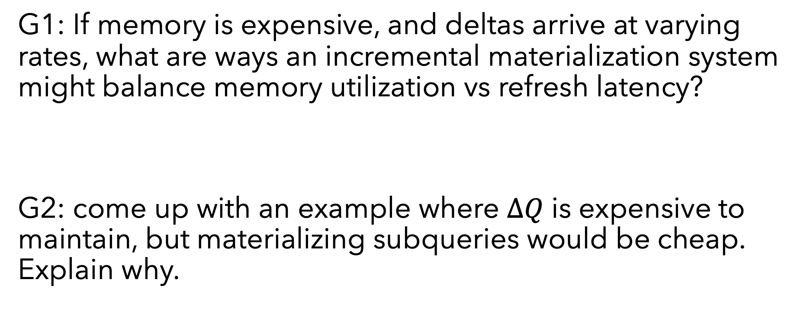
Each group assigns notetaker
G1: If memory is expensive, and deltas arrive at varying rates, what are ways an incremental materialization system might balance memory utilization vs refresh latency?
G2: come up with an example where $ΔQ$ is expensive to maintain, but materializing subqueries would be cheap. Explain why.

Slide 89

Support your colleagues
for speaking up
A quick thanks or follow up
is great
https://www.dreamstime.com/photos-images/dog-thumbs-up.html

Slide 90
Each group assigns notetaker
G1: If memory is expensive, and deltas arrive at varying rates, what are ways an incremental materialization system might balance memory utilization vs refresh latency?
G2: come up with an example where $ΔQ$ is expensive to maintain, but materializing subqueries would be cheap. Explain why.

Slide 91
Class 14
Materialized Views

Slide 92
Turn video on, open chat,
greet your colleagues in the chat!
Discussion prompt:
Have you watched the social dilemma?

Slide 93
Logistics
A3 deadline has passed. 5 grace days in effect
Paper draft 10/29
https://easychair.org/conferences/?conf=w611320
Invites emailed to serve on the program committee

Slide 94
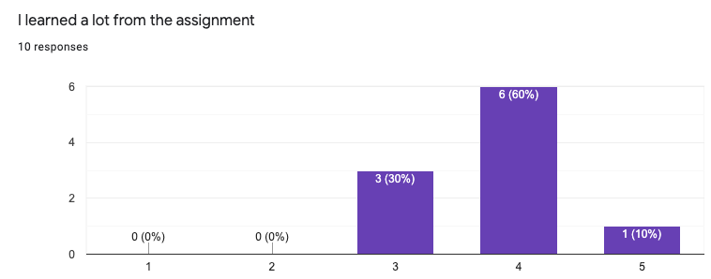
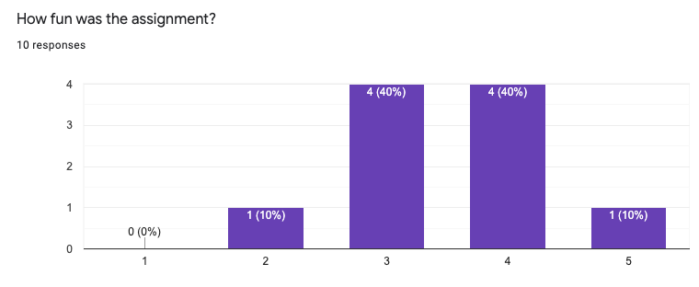
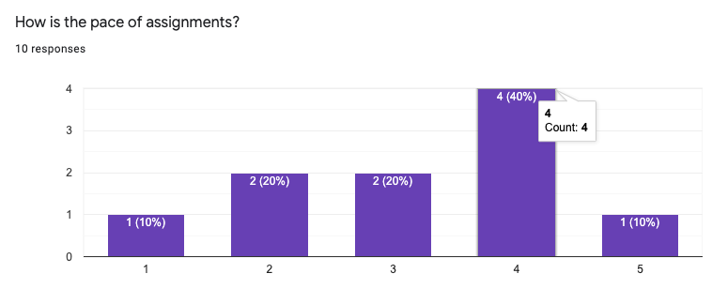

Slide 95
DB seminar talks
Vasiliki’s talk is 4-5:30PM!
Replaces Tuesday Class
9/29 Julia Stoyanovich (NYU)
Responsible Data Management
10/13 Wolfgang Gatterbauer (Northeastern)
QueryVis
10/20 Kostas Karanasos (Microsoft Gray Labs)
Lab overview + In-db ML inference
10/27 Vasiliki Kalavri (Boston U)
Streaming Research
11/10 Aaron Elmore (UChicago)
CrocodileDB
Zoom link in slack

Slide 96
Each group assigns notetaker
Discuss a non-database use case
that could be viewed from a
materialized view perspective
(systems, hardware, government, real-life, etc)
Explore the implications

Slide 97

SPEAKS UP
THUMB UP
Support your colleagues
for speaking up
A quick thanks or follow up
is great

Slide 98
Each group assigns notetaker
Discuss a non-database use case
that could be viewed from a
materialized view perspective
(systems, hardware, government, real-life, etc)
Explore the implications!

Slide 99
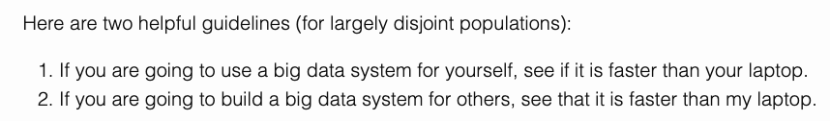
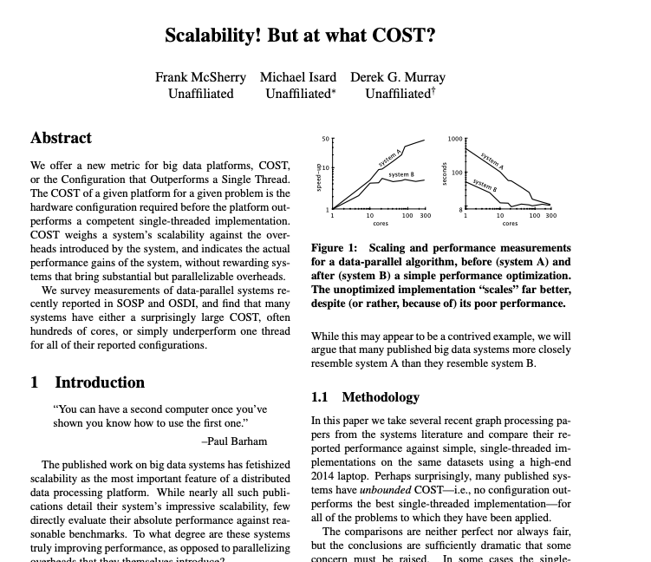

Slide 100
Class 13
Incremental Dataflow

Slide 101
Turn video on, open chat,
greet your colleagues in the chat!
Discussion prompt:
Favorite music artist/band!
Is this a sandwich?

Slide 102
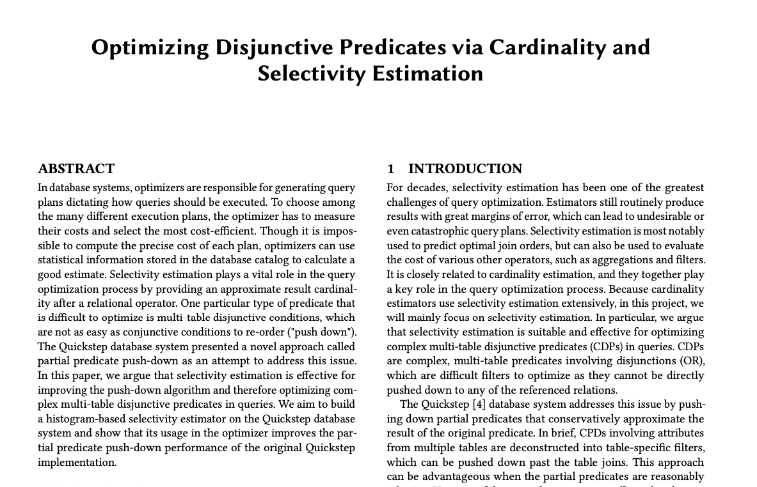
Logistics
A3 due 10/21
A4 out: hypothesis-driven experiment design
Paper draft 10/29
https://easychair.org/conferences/?conf=w611320
Invites emailed to serve on the program committee
Example draft submission from 2019 w6113

Slide 103
Draft: Reproduce and Extend
Introduction
The motivation for what you will reproduce.
Clear reason for why the system you will implement within is appropriate.
Technical Approach
Detailed description of algorithms you will reproduce, and specifically how they will be implemented
Experiments
List the hypothesis, baselines experiment designs
OK to not have run experiments

Slide 104
Draft: Research Project
Introduction
The argument flow from problem to your novelty should be clear
Technical Approach
Describe a naïve version of your solution highlights the ideas (but may be inefficient/unoptimized)
Experiments
List the hypothesis, baselines experiment designs
OK to not have run experiments
Related Work
Define dimensions that distinguish your work from prior works
Timely Dataflow defines similar categories:
Acyclic batch data flow
Incremental computation
Stream processing systems
Cyclic dataflows
See How to Architect a Query Complier, Revisited for a strong related works section

Slide 105
DB seminar talks
9/29 Julia Stoyanovich (NYU)
Responsible Data Management
10/13 Wolfgang Gatterbauer (Northeastern)
QueryVis
10/20 Kostas Karanasos (Microsoft Gray Labs)
Lab overview + In-db ML inference
10/27 Vasiliki Kalavri (Boston U)
Streaming Research
11/10 Aaron Elmore (UChicago)
CrocodileDB
TODAY
Zoom link in slack

Slide 106
Each group assigns notetaker
G1: Suppose data arrives in timestamp order, and the dataflow groups by timestamp. What drawbacks would Naiad exhibit compared to batch systems? How could they be addressed?
G2: To what extent could a batch system (e.g., Spark, Cloud DB) be adopted to support Naiad’s ideas? Try to sketch a solution
G3: Let’s say you built a SQL engine on top of Naiad. What properties would the engine have beyond a typical SQL engine?

Slide 107

Support your colleagues
for speaking up
A quick thanks or follow up
is great
2 Thumbs 4 SPEAKING UP
https://thumbsandammo.blogspot.com/

Slide 108
Each group assigns notetaker
G1: Suppose data arrives in timestamp order, and the dataflow groups by timestamp. What drawbacks would Naiad exhibit compared to batch systems? How could they be addressed?
G2: To what extent could a batch system (e.g., Spark, Cloud DB) be adopted to support Naiad’s ideas? Try to sketch a solution
G3: Let’s say you built a SQL engine on top of Naiad. What properties would the engine have beyond a typical SQL engine?

Slide 110
Class 12
Batch Dataflow

Slide 111
Turn video on, open chat,
greet your colleagues in the chat!
Warmup discussion:
What would be a good warmup discussion
for next class?

Slide 112
Logistics
A3 due 10/21
Paper draft: 11/29. Submit through conf review site

Slide 113
DB seminar talks
9/29 Julia Stoyanovich (NYU)
Responsible Data Management
10/13 Wolfgang Gatterbauer (Northeastern)
QueryVis
10/20 Kostas Karanasos (Microsoft Gray Labs)
Lab overview + In-db ML inference
10/27 Vasiliki Kalavri (Boston U)
Streaming Research
11/10 Aaron Elmore (UChicago)
CrocodileDB
Zoom link in slack

Slide 114
Each group assigns notetaker
G1: Compare MR and RDD’s fault tolerance approaches (assumptions, where information is managed, etc)
G2: Compare the different “big data” systems we’ve read so far: Dremel/Snowflake, Spark, MR, Parallel DBs. What dimensions matter?
G3: Translate the concepts in RDDs into database terminology.

Slide 115

Support your colleagues
for speaking up
A quick thanks or follow up
is great
SPEAKING UP
https://thumbsandammo.blogspot.com/

Slide 116
Each group assigns notetaker
G1: Compare MR and RDD’s fault tolerance approaches (assumptions, where information is managed, etc)
G2: Compare the different “big data” systems we’ve read so far: Dremel/Snowflake, Spark, MR, Parallel DBs. What dimensions matter?
G3: Translate the concepts in RDDs into database terminology.

Slide 117
Class 11
UDFs

Slide 118
Turn video on, open chat,
greet your colleagues in the chat!
Warmup discussion:
What shows are you watching these days?

Slide 119
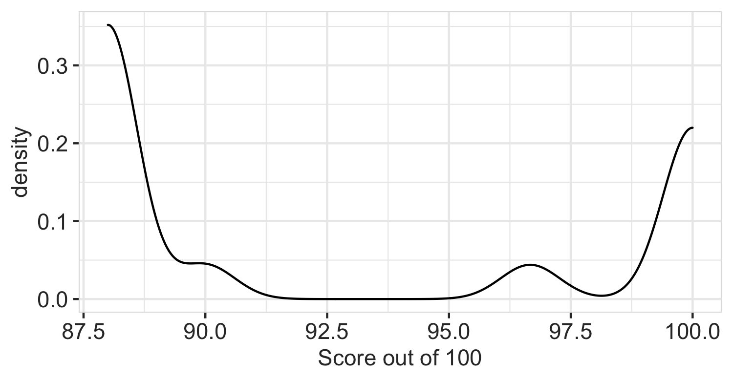
Logistics
A2 graded, reference code is out
A3 due 10/21
Paper draft: 11/29

Slide 120
DB seminar talks
TODAY
9/29 Julia Stoyanovich (NYU)
Responsible Data Management
10/13 Wolfgang Gatterbauer (Northeastern)
QueryVis
10/20 Kostas Karanasos (Microsoft Gray Labs)
Lab overview + In-db ML inference
10/27 Vasiliki Kalavri (Boston U)
Streaming Research
11/10 Aaron Elmore (UChicago)
CrocodileDB
Zoom link in slack

Slide 121
Each group assigns notetaker
G1: Come up with some killer use cases for UDFs. (Combined with user defined types, UDFs are very powerful!)
G2: WHEN and HOW do UDFs pose a problem for query optimization and execution?
G3: Beyond caching, what other tricks might accelerate queries that use UDFs

Slide 122

Support your colleagues
for speaking up
A quick thanks or follow up
is great
https://en.wikipedia.org/wiki/Thumb_signal

Slide 123
Each group assigns notetaker
G1: Come up with some killer use cases for UDFs. (Combined with user defined types, UDFs are very powerful!)
G2: WHEN and HOW do UDFs pose a problem for query optimization and execution?
G3: Beyond caching, what other tricks might accelerate queries that use UDFs

Slide 124
Class 10
Query Compilation

Slide 125
Turn video on, open chat,
greet your colleagues in the chat!
Warmup discussion:
What are some types of disaggregation in your daily life?
When is it sensible to disaggregate vs consolidate?

Slide 126
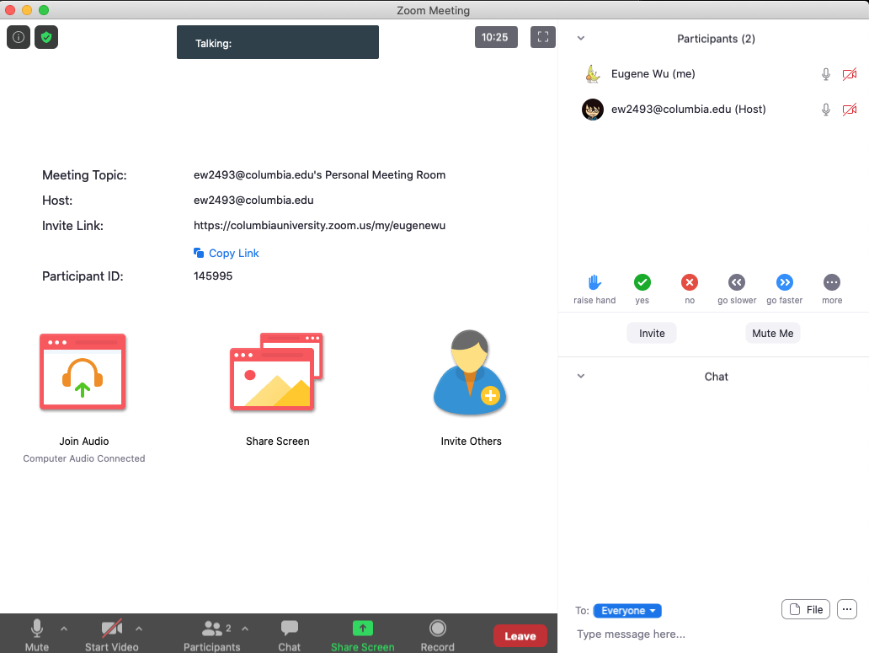
Logistics
Thanks for the bug reports!
Vote: Share and review paper drafts (due 10-22)?

Slide 127
DB seminar talks
9/29 Julia Stoyanovich (NYU)
Responsible Data Management
10/13 Wolfgang Gatterbauer (Northeastern)
QueryVis
10/20 Kostas Karanasos (Microsoft Gray Labs)
Lab overview + In-db ML inference
10/27 Vasiliki Kalavri (Boston U)
Streaming Research
11/10 Aaron Elmore (UChicago)
CrocodileDB
Zoom link in slack

Slide 128
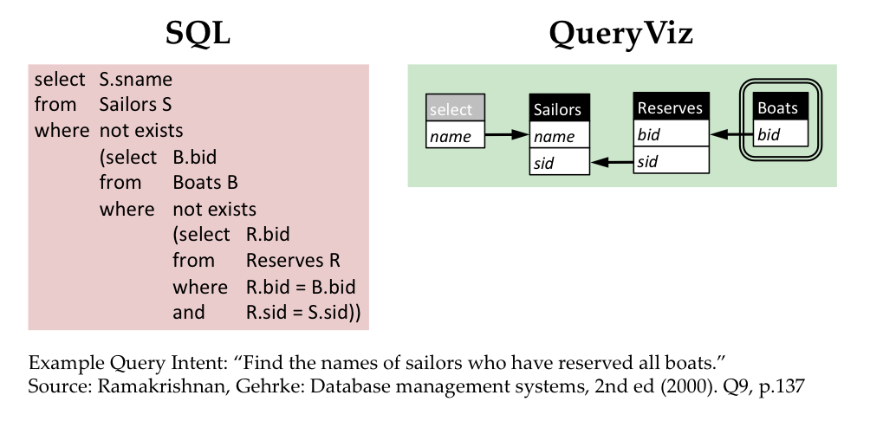
Queryvis.com

Slide 129
Breakout Qs
Choose a notetaker that as not been a notetaker in the past

Slide 130
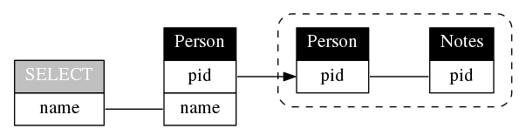
Breakout Qs
Choose a notetaker that as not been a notetaker in the past
SELECT name
FROM Person P
WHERE P.pid NOT IN (
SELECT P2.pid
FROM Person P2, Notes N
WHERE P2.pid = N.pid
)

Slide 131
Breakout Qs.
G1: Compare Hyper’s compilation vs MonetDB’s vectorization or Volcano. In what specific cases is one better and why?
G2: What logic makes sense to keep in C++ as opposed to LLVM? List some examples and why.
G3: How is query compilation tricky from a software engineering perspective? What could be done to improve this aspect?
Each group assigns notetaker to report back (1m)

Slide 132
Support your colleagues
for speaking up
A quick thanks or follow up
is great
https://en.wikipedia.org/wiki/Thumb_signal

Slide 133
Breakout Qs.
G1: Compare Hyper’s compilation vs MonetDB’s vectorization or Volcano. In what specific cases is one better and why?
G2: What logic makes sense to keep in C++ as opposed to LLVM? List some examples and why.
G3: How is query compilation tricky from a software engineering perspective? What could be done to improve this aspect?
Each group assigns notetaker to report back (1m)

Slide 134
Class 9
Cloud DBs

Slide 135

Turn video on, open chat, then click
Warmup discussion:
You’ve read industry and academic papers.
What do you feel are the strengths and weaknesses?

Slide 136
Logistics
A3 released
A5 is extra credit (optional)
Proposal comments sent via slack
Keeping existing lecture sequencing
was partly to time with Prof Vasiliki’s talk

Slide 137
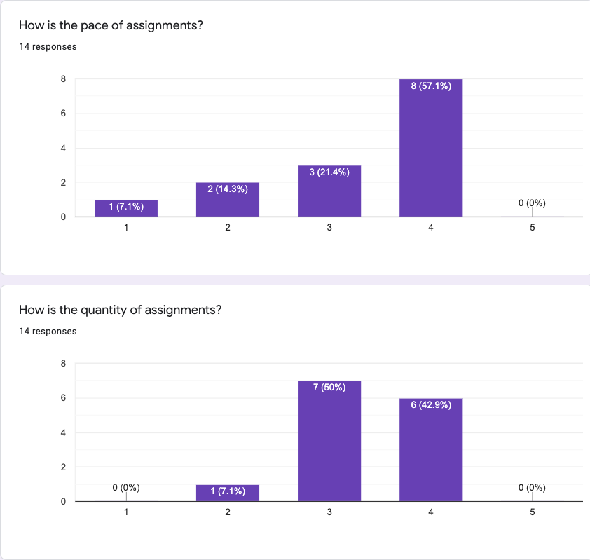
Comments
Almost Unrelenting
Go over assignment & concepts in class (x2)
More tests (x4)
Note: 5 late days

Slide 138
Breakout Qs.
G1: What are the similarities between Dremel/Snowflake and Gamma? What are the differences?
G2: Does in-situ processing really mean? For instance, does data not need to be loaded? What are its strengths and drawbacks?
G3: Speculate about future iterations software or hardware “disaggregation. How might it affect DBMS design?
Each group assigns notetaker to report back (1m)

Slide 139
Class 8
Column Stores

Slide 140
Turn video on, open chat, then click
Warmup discussion:
Which restaurant do you want to go most
when dine-in is safe again?

Slide 141
Logistics
Proposal due today 11:59PM EST
A2 due 10/4 11:59PM EST
A5 is now optional
Questions
Extend A3 and A4 by 1 week?
Swap Compilation/Udf topics with large scale dataflow?

Slide 142
Breakout Qs.
G1: What makes this paper well-written? Identify specific examples from the reading.
G2: Still assuming a ”big reads” workload, how would col-stores adapt to data distribution changes?
G3: Compare and contrast the in-memory vs on-disk “stores” in c-store to the design in a class RDBMS
Each group assigns notetaker to report back (1m)

Slide 143
Class 7
Query Optimizer

Slide 144
Turn video on, open chat
Warmup discussion:
Is a hot dog a sandwich?
3. Click when done

Slide 145
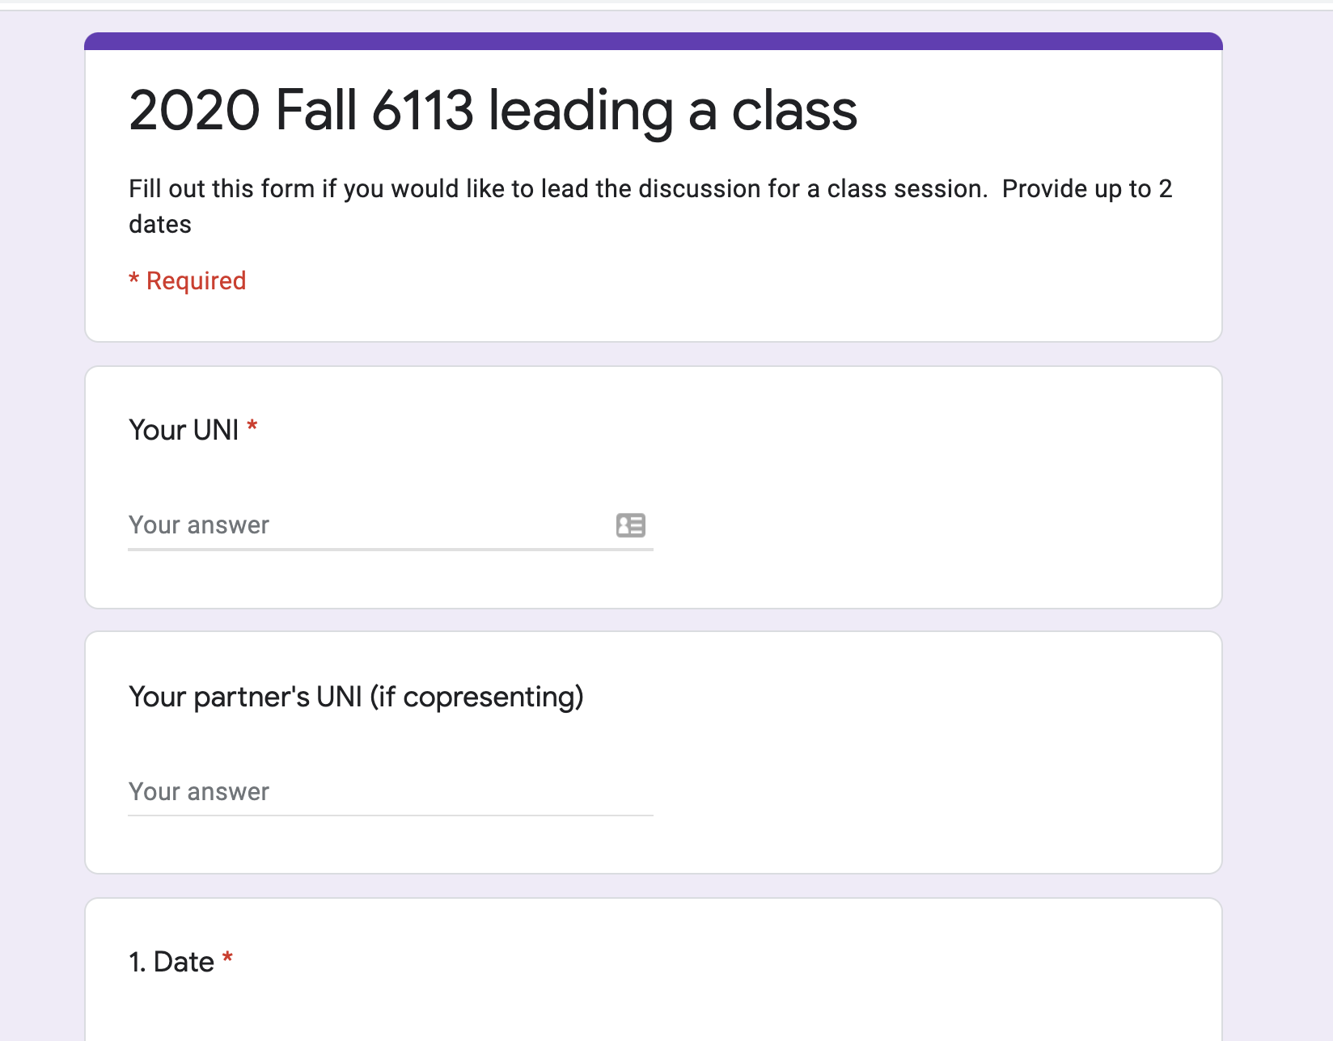
Logistics
Project proposals due 10/1
A2 due 10/4
Sign up to lead a class (TODAY)

Slide 146
DB seminar talks
9/29 Julia Stoyanovich (NYU)
Responsible Data Management
10/13 Wolfgang Gatterbauer (Northeastern)
QueryVis
10/20 Kostas Karanasos (Microsoft Gray Labs)
Lab overview + In-db ML inference
10/27 Vasiliki Kalavri (Boston U)
Streaming Research
11/10 Aaron Elmore (UChicago)
CrocodileDB
Zoom link in slack

Slide 147
Breakout Qs.
G1: Why is writing query optimizers harder than rocket science?
G2: Propose good methods to select promising transitions
G3: What are some benefits of volcano’s top-down search as compared to selinger’s algorithm? Hint: consider enforcers
G4: How to parallelize cascades? What challenges may arise?
Each group assigns notetaker to report back (1m)

Slide 148
Class 6

Slide 149
Do The Following
Turn video on
Type in chat or say:
Agree or disagree
Batman is a criminal
3. Click when done

Slide 150
Logistics
Project proposals due 10/1
A2 due 10/4
Sign up to lead a class (link on website, slack)

Slide 151
DB seminar talks
9/29 Julia Stoyanovich (NYU)
Responsible Data Management
10/13 Wolfgang Gatterbauer (Northeastern)
QueryVis
10/20 Kostas Karanasos (Microsoft Gray Labs)
Lab overview + In-db ML inference
10/27 Vasiliki Kalavri (Boston U)
Streaming Research
11/10 Aaron Elmore (UChicago)
CrocodileDB
Zoom link in slack

Slide 152
Breakout Qs. Provide specific examples
G1 Writing: What did the paper focus on & not focus on? Why?
G2 Contribs: What is the main contribution?
Design an example that highlights it against prior work.
G3 Exps: Based on the paper’s aims, what exps should they have run? Did they? If not, design a specific exp they should have run.
G4 Future: Describe a major follow up question to study.
Each group assigns notetaker to report back (1m)

Slide 153
Breakout
Discussion:
Discuss
Notetaker:
Summarize the discussion (~30s)

Slide 154
Class 5

Slide 155
Do The Following
Turn video on
Type in chat or say:
My favorite time of day is
___ ______
3. Click when done

Slide 156
Logistics
Today: multi-machine joins
A2 is out – optimizer!
A1 – what did you learn? What did you already know?

Slide 157
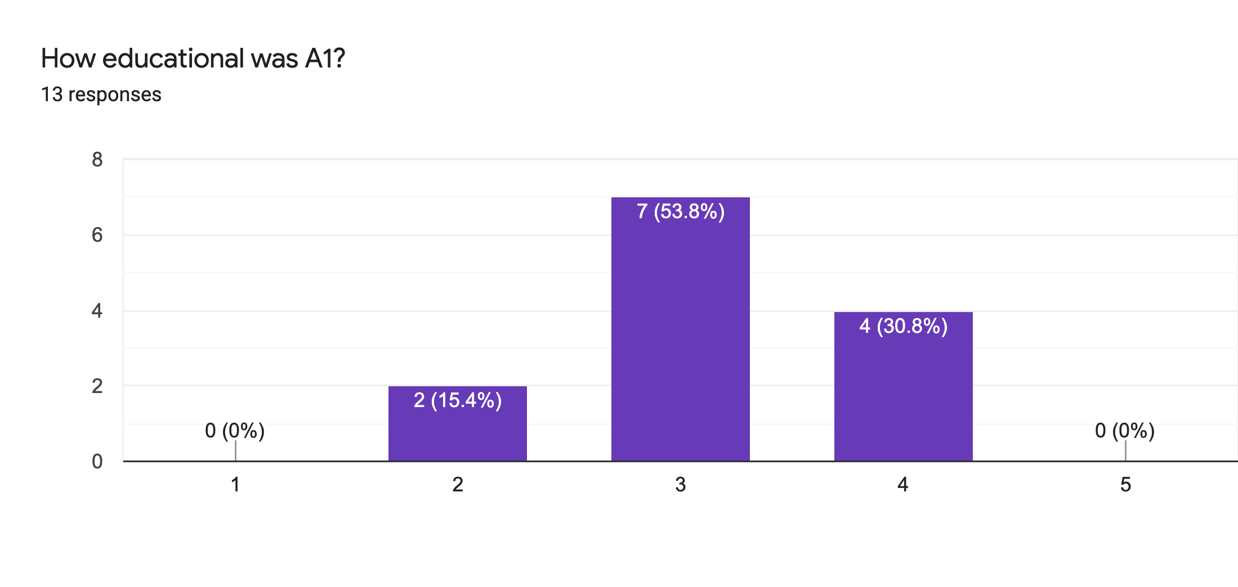
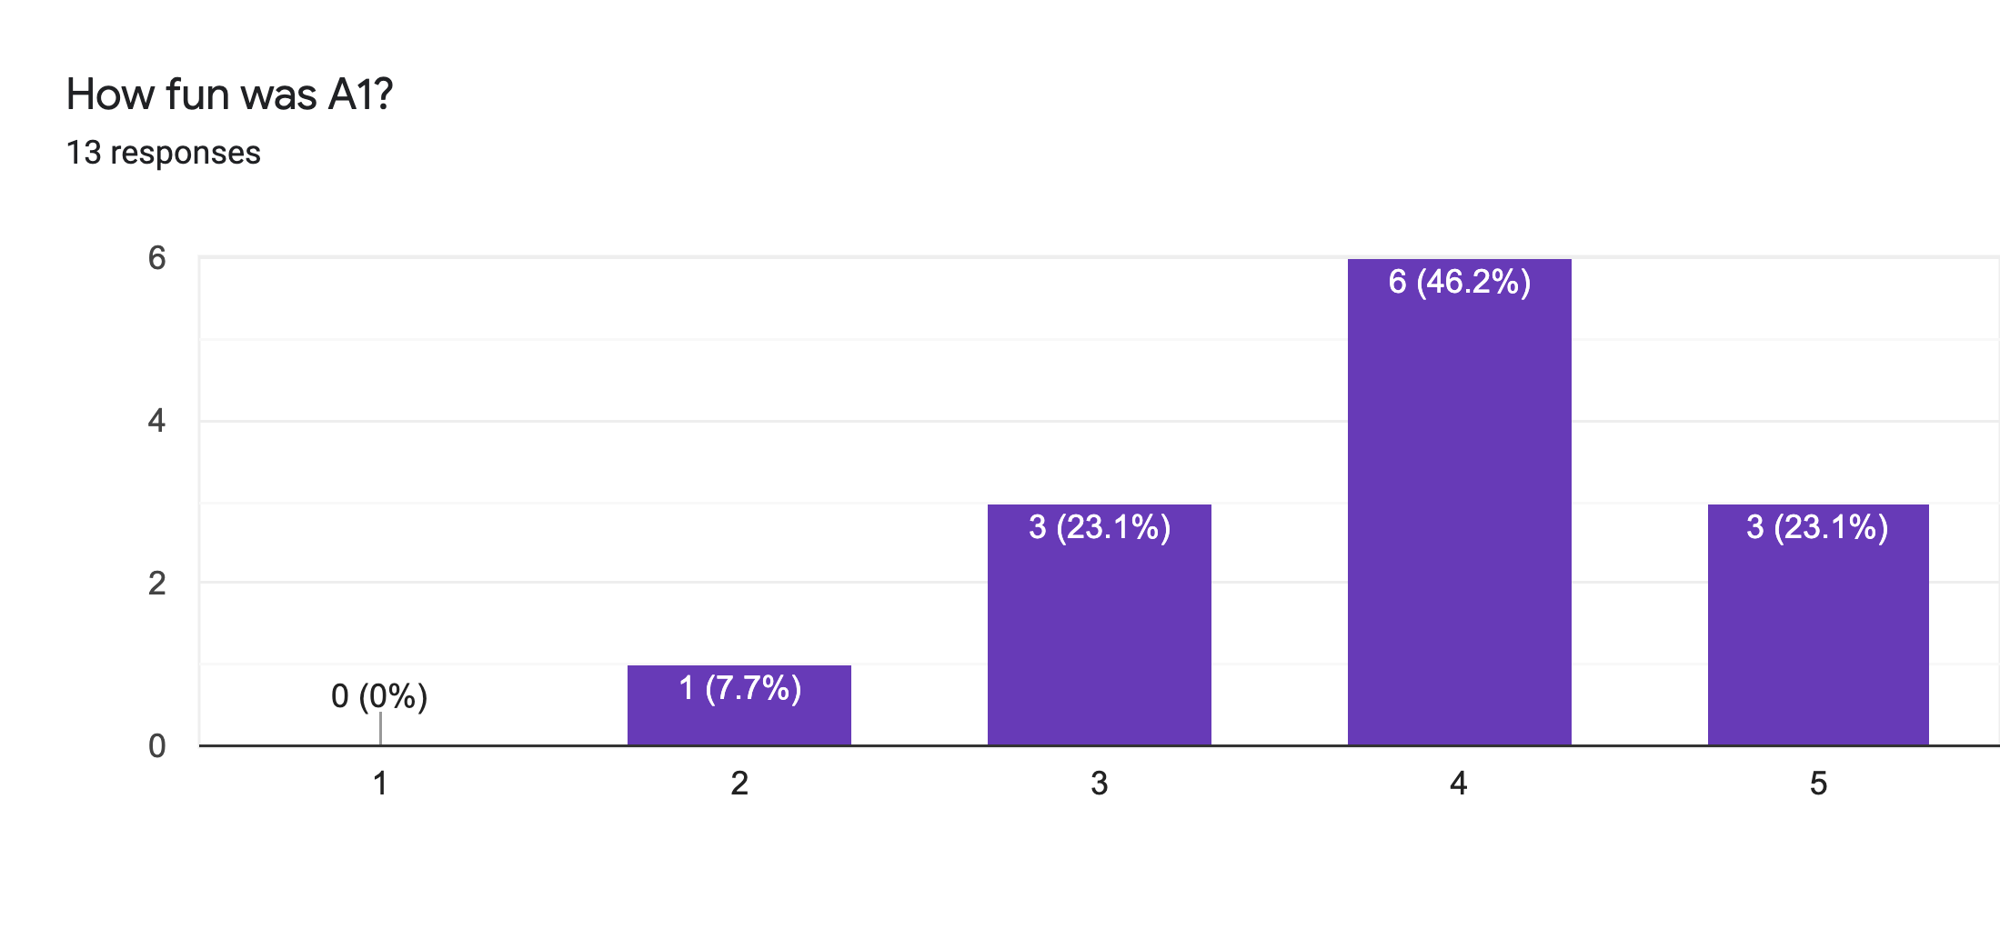
Main Comments
Vague Instructions
Bugs 🙏

Slide 158
Reviews
Strengths
Clear, honest writing
Ability to scale up/out is a big win!
Experiment design + explanation: A+

Slide 159
Reviews
Weaknesses
Lacks baselines
Aggregation?
Explain terms
How to choose partitioning key?
If scales to 1000+ nodes, what bottlenecks?
Failure on recovery?

Slide 160
Class 4

Slide 161
Do The Following
Turn video on
Type in chat or say:
A book/article I recently read
was ___ ______
3. Click when done

Slide 162

Today’s session
Finish previous class NO NEED!
Single Machine Joins.
Poll: paper reviews in pairs?

Slide 163
Today’s session
Finish previous class NO NEED!
Single Machine Joins.
Poll: paper reviews in pairs?
Poll: random pairing each week?

Slide 164
Breakout
Discussion:
Is a hot dog a sandwich? Discuss
Notetaker:
Summarize the discussion (~30s)

Slide 165
Discussion
Novelty
Theoretical guarantees
Experiment design

Slide 166
Class 3

Slide 167
Do The Following
Turn video on
Type in chat or say:
My favorite morning drink is ___ ___
(as much detail as you wish)
3. Click
Participants
Chat

Slide 168
Today’s session
Finish previous class
Multi-dimensional indexing
A1 is out, due 9/20

Slide 169
Breakout
Discussion:
Share your favorite quick cooking recipe,
or what you would like to cook
Notetaker:
Summarize the discussion (~30s)

Slide 170
Discussion
Novelty
Theoretical guarantees
Experiment design

Slide 171
Class 2

Slide 172
Turn video on,
enable mic & say:
“Hi, this is _(name)_,
I ate ___________ for breakfast”
Click when done
Participants
Chat

Slide 173
Logistics
Walk through
A0
Paper Reviews
Project list is up (still evolving)
Course goal
You feel comfortable reading papers + conducting research
Research ~ answering your own questions

Slide 174
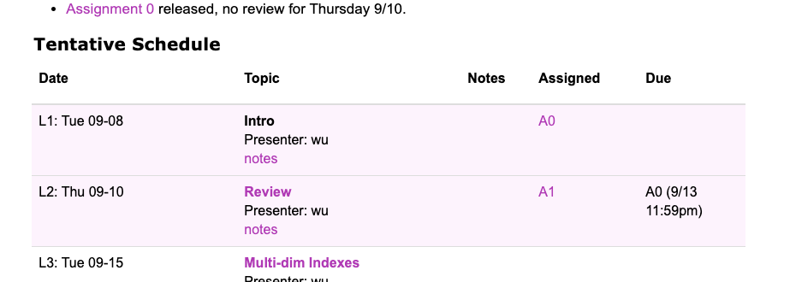
Today’s session
Finish previous class
Review classic DBMS components
Notes on w6113.github.io

Slide 175
#ScholarStrike
Notes:
Supposed to be a two day strike where you don’t do any professor related tasks and learn about BLM and challenges of underrepresented people, and what can be done to help

Slide 176

Black Lives Matter
Notes:
Discuss where all of this started and popularized this year, which, for me was the black lives matter protests.
BLM has been around for many years, but the very public, and unfair, murders of black people by police ignited the movement
For instance, geore floyd

Slide 177
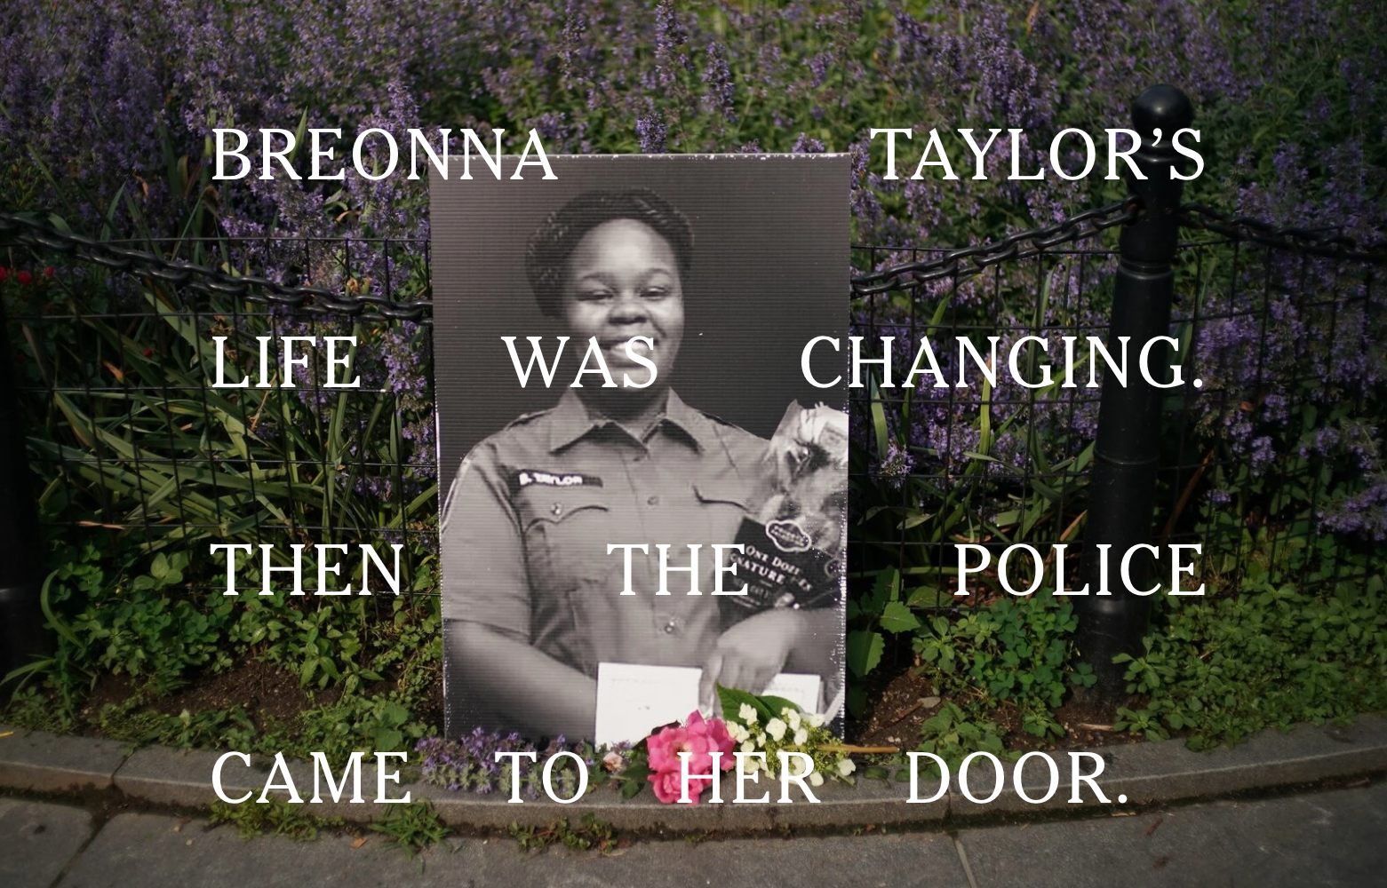
Black Lives Matter
Notes:
Breonna Taylor was a nurse just at home in her apartment

Slide 178

Black Lives Matter
Notes:
Linden Cameron was a 13 year old shot in the back

Slide 179

Black Lives Matter
Notes:
And Daniel Prude who was pinned and hooded by officers, who then blamed it on drug overdose, which leverages deep seated biases about black people.
These events are tragic, and simply symptoms of a deep disparity between African americans and the rest of America.
The US has historically treated immigrants of all kinds poorly, but African americans have been systematically oppressed from day one of the nation’s founding.
BLM is simply the manifestation of the outrage at this inequity

Slide 180
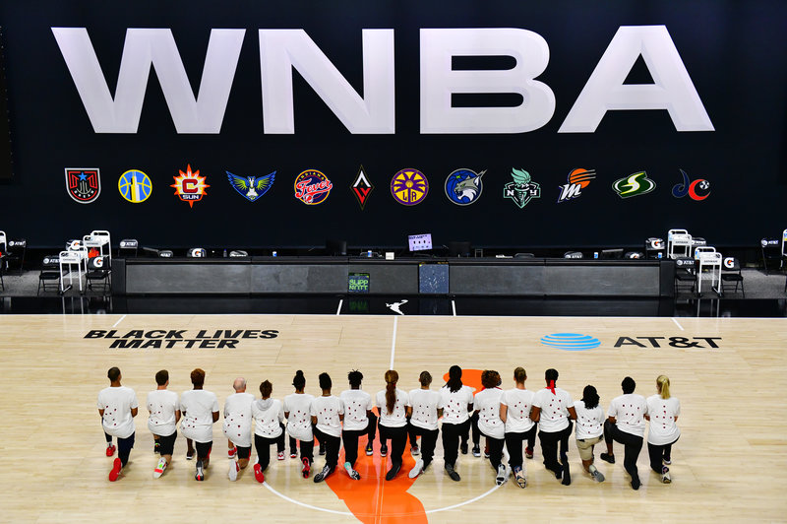
Notes:
Recently the WNBA led the sports world in going on a strike to further publicize this issue, and other sports leaguse followed.
ScholarStrike was a reaction by academics in support of this

Slide 181
Search terms to learn more
john oliver police
Netflix 13th
The case for reparations
shutdownstem
Notes:
Rather than cancel class, I’ll list here terms that are worth searching for to educate your self a bit about what’s going on. We will share these terms in the slack.
These are issues that I am not an expert in either, but I am happy to discuss these in recitation or OH.

Slide 182
Your Tasks for next class
Submit reviews for Tuesday
Submit Assignment 0 by 9/13 11:59PM EST
w6113.github.io

